Slide 1
ELEMENTAL
RUN
A GAME MADE BY – GAMERS2MAKERS

Slide 2
01.
ABOUT US

Slide 3
02.
Art

Slide 4




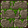
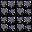

















Slide 5
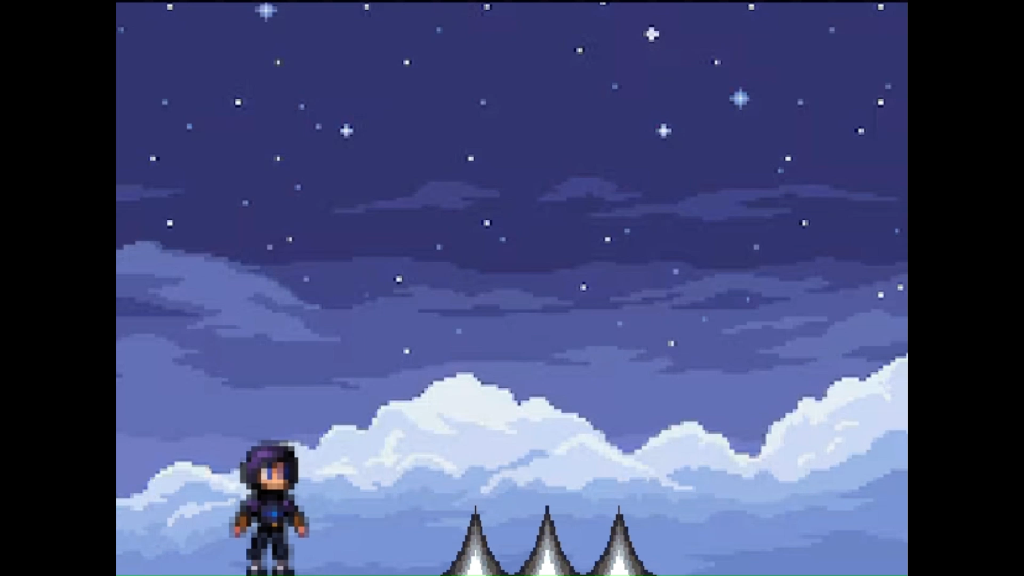

03.
MECHANICS

Slide 6
3D MODELLING
--VAIBHAV

Slide 7
THANKS!
VAIBHAV, ABHIRAM, BRIJESH

Slide 8
RESOURCES
Did you like the resources on this template? Get them for free at our other websites:
VECTORS
Naive retro videogames stickers I
Naive retro videogames stickers II
Naive retro videogames stickers III
Naive retro videogames stickers IV
ICONS
Icon Pack Arcade
PHOTOS
Medium shot happy man playing game
Happy couple playing with game controllers
Full shot man playing videogame
Full shot girl playing videogame
Father and son playing video games with controllers

